Slide 1

Department of Research and Development

Slide 2
Importance of R & D
Role of research in an academic institution is significant for its sustainability and development, and it is important to have knowledge-driven growth based on innovation.
The quality of research work directly translates to the quality of teaching and learning in the classroom, thereby benefiting the students, the society and the country.
The promotion of research in a huge and diverse country like India will help the nation evolve as a knowledge reservoir in the international arena.
Research plays a significant role in accreditations as well as the rankings of the institution, which ultimately enable us to attract top talent in terms of both students and faculty.

Slide 3
VISION & MISSION
Vision
To achieve excellence in Research & Innovation, in the field of Engineering and Management which can help the society and nation
Mission
To promote research and innovation among students and faculty members in collaboration with industry that align with institutional strategic plan.
To transform the research work and innovative ideas into start-up in line with AatmaNirbhar Bharat

Slide 4
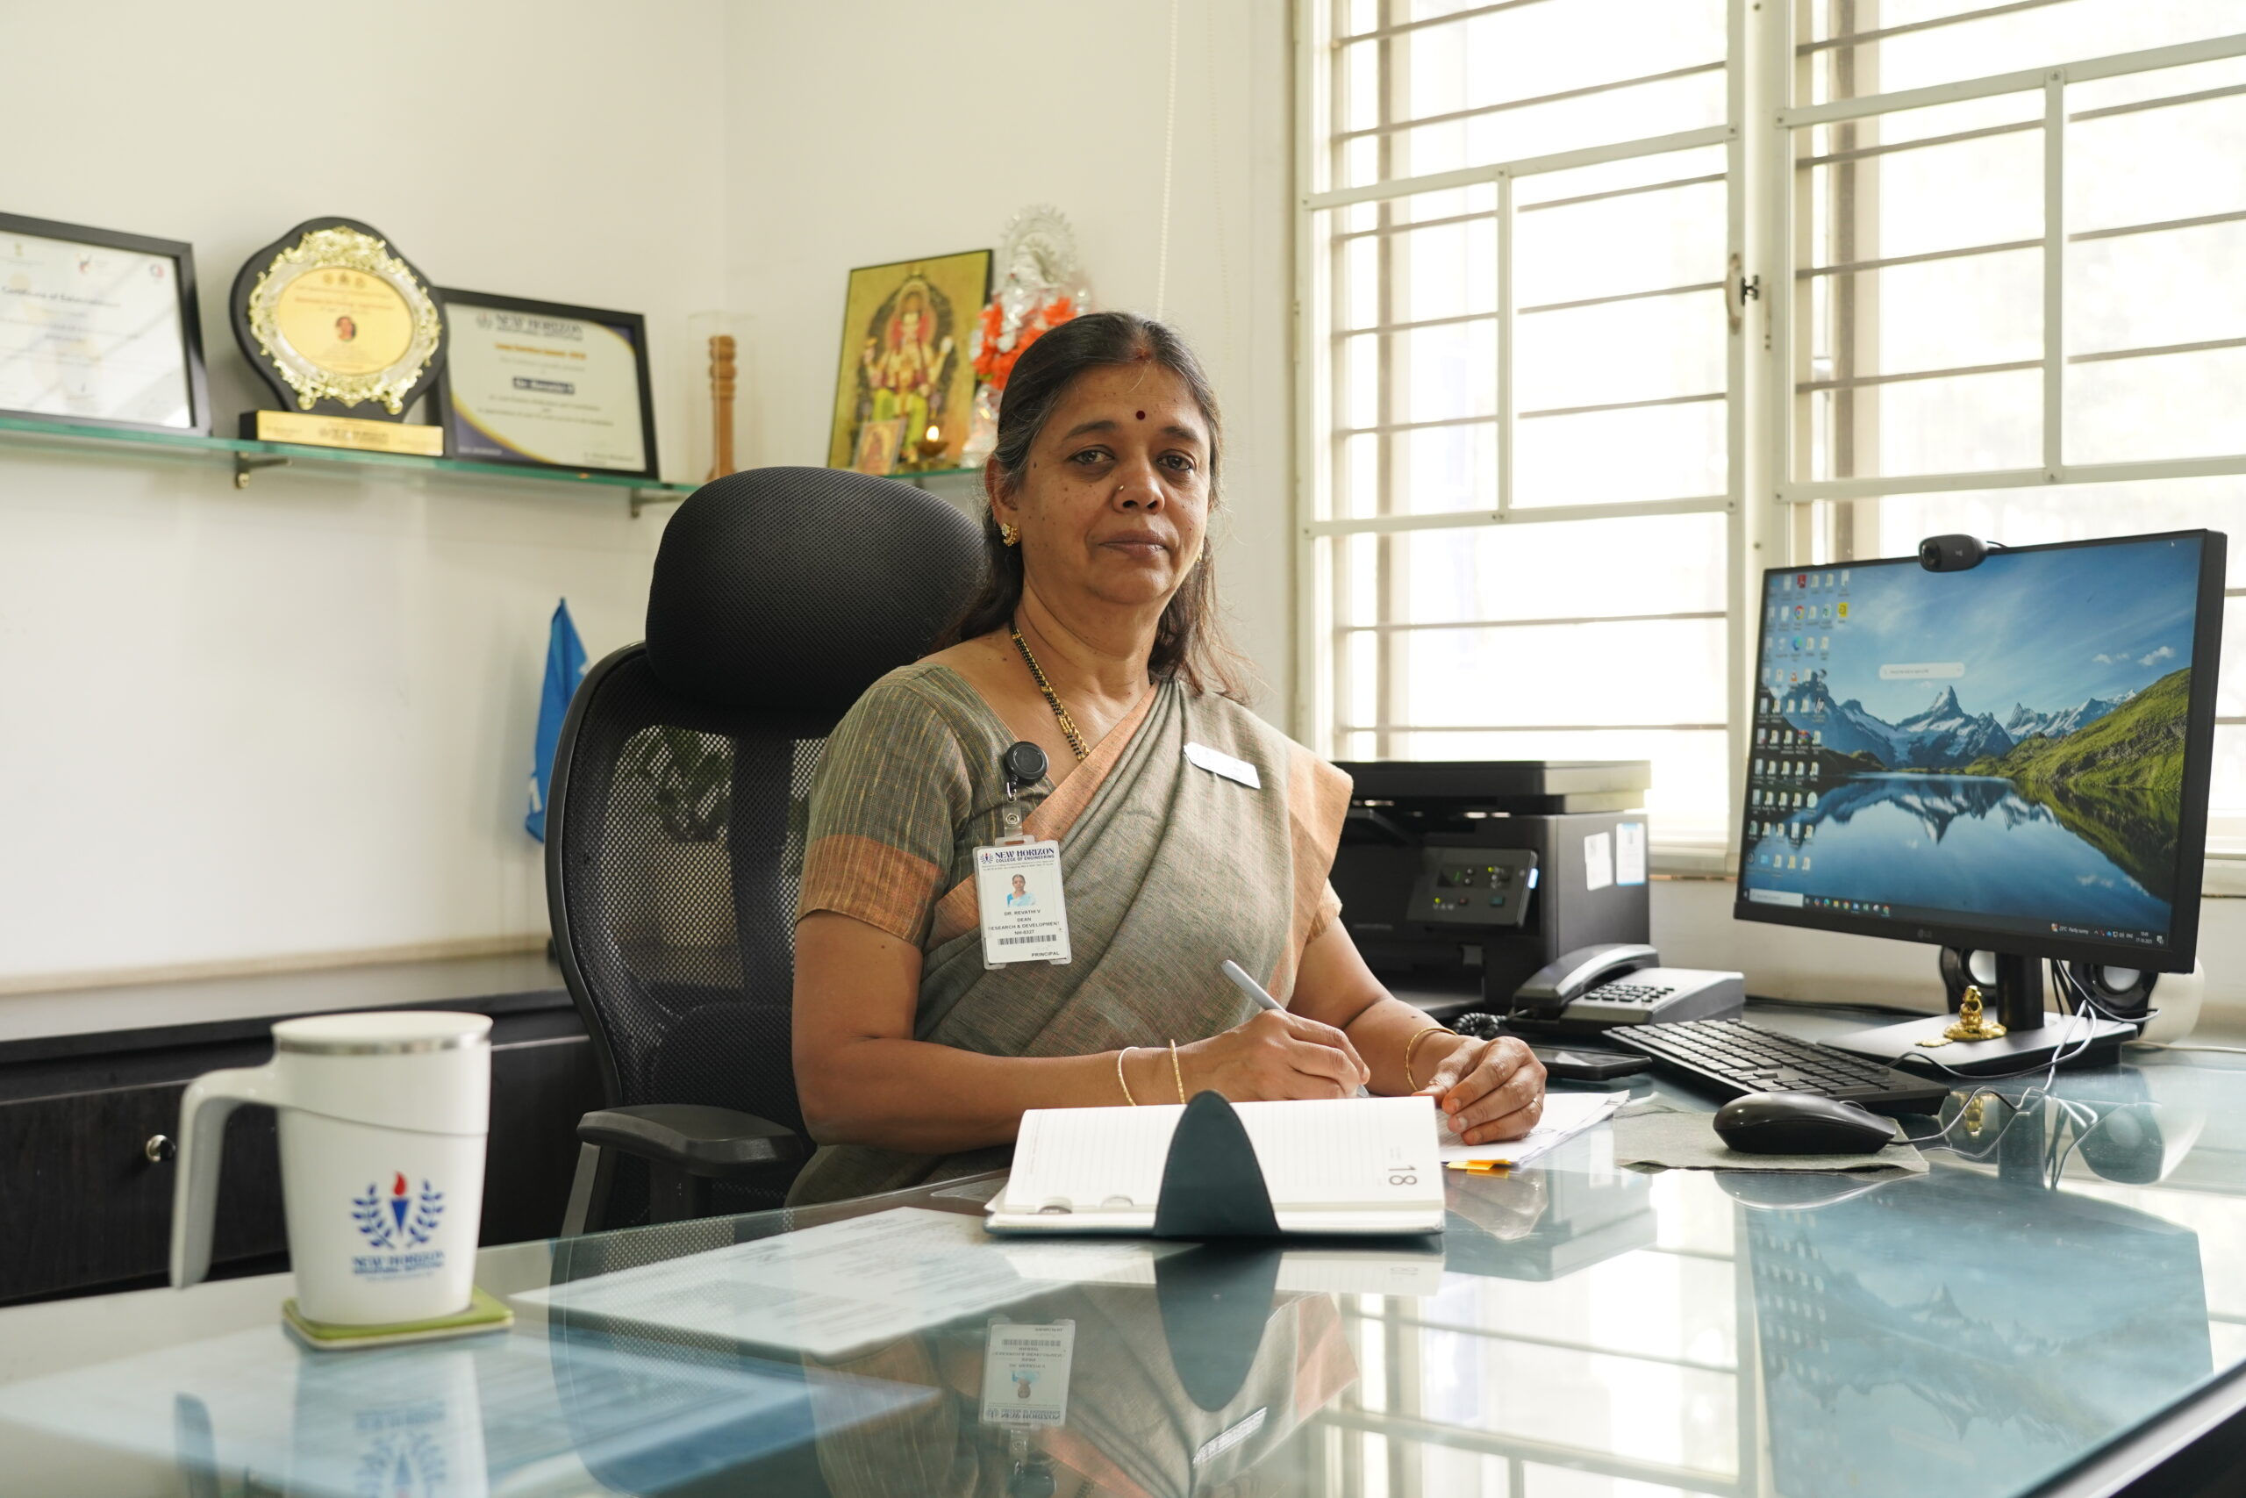
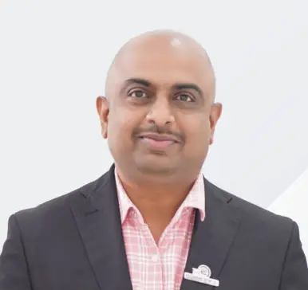

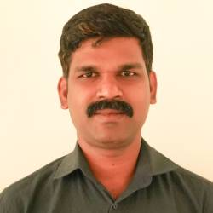
Team - R & D
Dr. Revathi V
Professor & Dean – R&D
Dr. Vinoth Kumar K
Professor and Associate Head – R&D
(Publications & Research Grants)
Dr. Agalya V
Professor and Associate Head – R&D
(IPR)
Dr. Sujin Jose V
Associate Professor
(IIC Incharge)

Slide 5
Goals
To make the NHCE a worthy knowledge centre by developing research and extension activities in association with professional bodies/industries/research establishments.
To create awareness among faculty members and students about the availability and access to research grants, funding formats etc and appropriately hand hold them to get such funds/grants.
To development close collaboration with industry through exchange of personnel and undertaking consultancy projects.
To improve a strong collaboration links with other academic and research institutions in the country and abroad.
To ensure the participation of students in various R&D or Design Competitions/Awards within India and Abroad.
To establish excellent academic research support facilities (laboratory, library, Internet, etc.)
To provide opportunities for continuous updating the knowledge of faculty through faculty interventions/exchanges from premier institutions and industries/R&D Labs.
To establish procedures and methodologies for regular monitoring and control of quality of research in academic departments
To increase Institute-Industry interaction/Collaboration, Entrepreneurship Development/Technology Business Incubation/start-ups.

Slide 6
Roles and Responsibilities
Facilitate growth of research activity in the Faculty, including developing mechanisms and targets to achieve.
Develop and maintain, coordinate and plan the development of research infrastructure across the Faculty.
Develop and coordinate strategies for maximizing the Faculty success in gaining external research funding.
Develop strategies to foster research collaborations within the Faculty, across Faculty and Institutes, industries and with International Connect.
Formulate faculty incentive provisions with respect to article publications in peer-reviewed journals.
Promote/ encourage faculty-student research leading to obtain patents.
Strive for high research planning activities and promote research culture across the Institute.

Slide 7
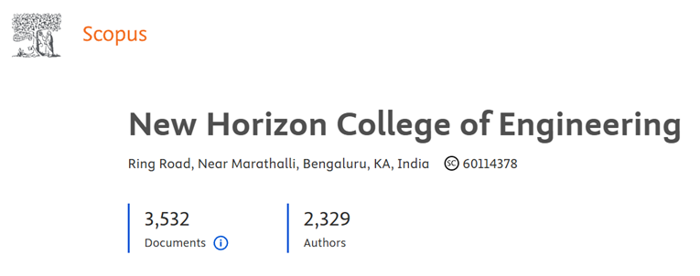
Research Culture
Research Culture
Student Projects
Collaborative Research
Inter-disciplinary
Outside Collaboration
Research Grants
Patents
Consultancy Projects
Research Publications
As a student having good grades, industrial experience and internships is great, but it is not always enough to stand out from the crowd. To enhance the research capabilities of the student, NHCE encourages and helps them to publish their projects in conferences and journals. Research is all about bringing new ideas and perspectives to your field of study, and sharing them with a wider audience through research articles. Publishing high-quality papers is the best way to showcase your research group's success and productivity in academia.
Conference Paper | 1950
Article | 1211
Book Series | 163
Book | 208

Slide 8
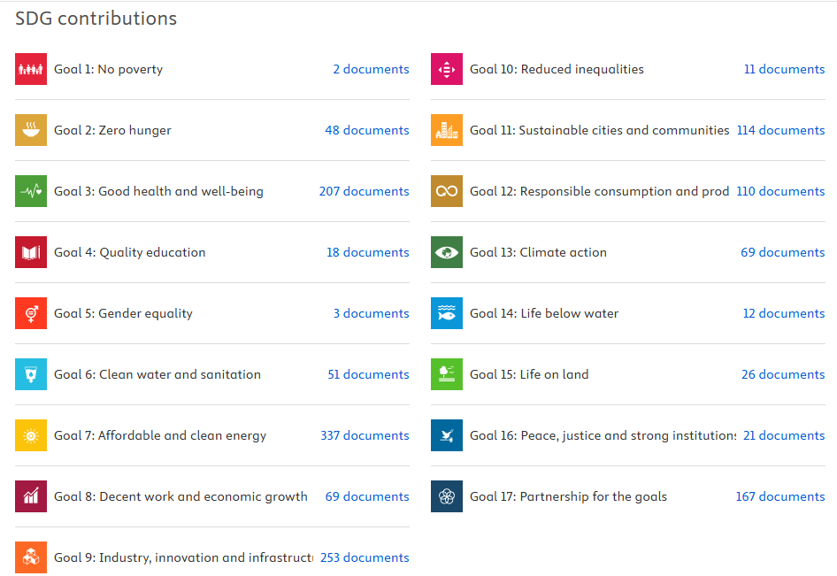
Sustainable Development Goals (SDGs)

Slide 9


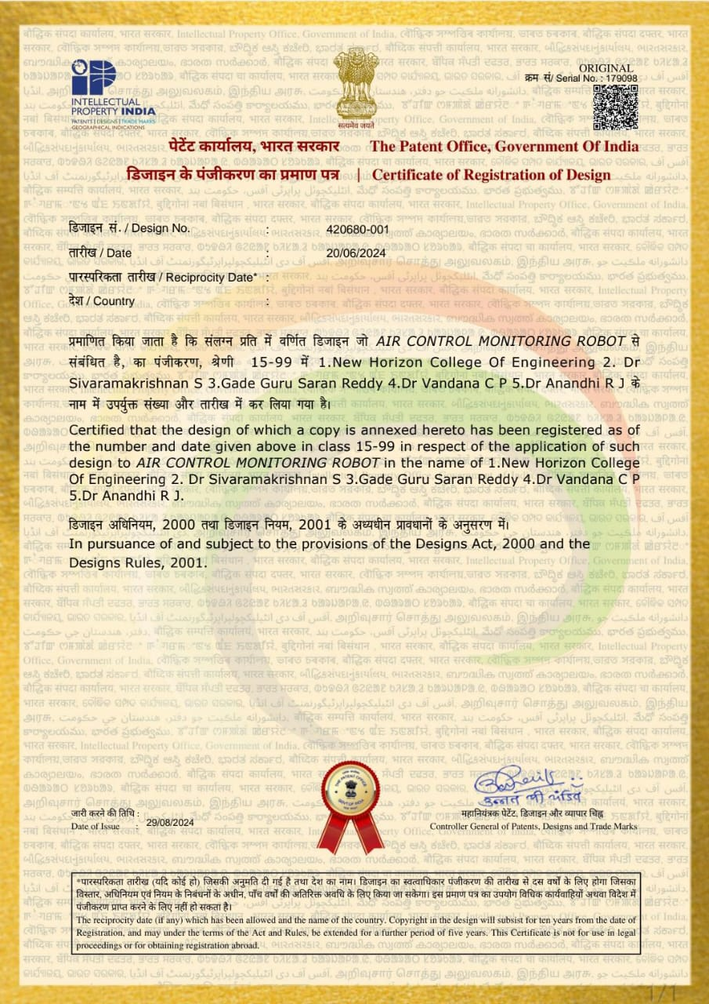
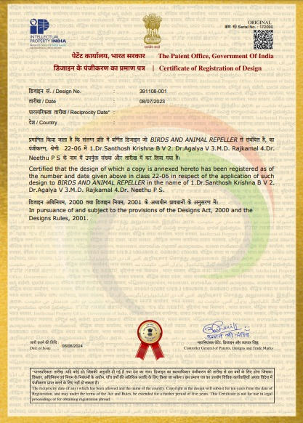

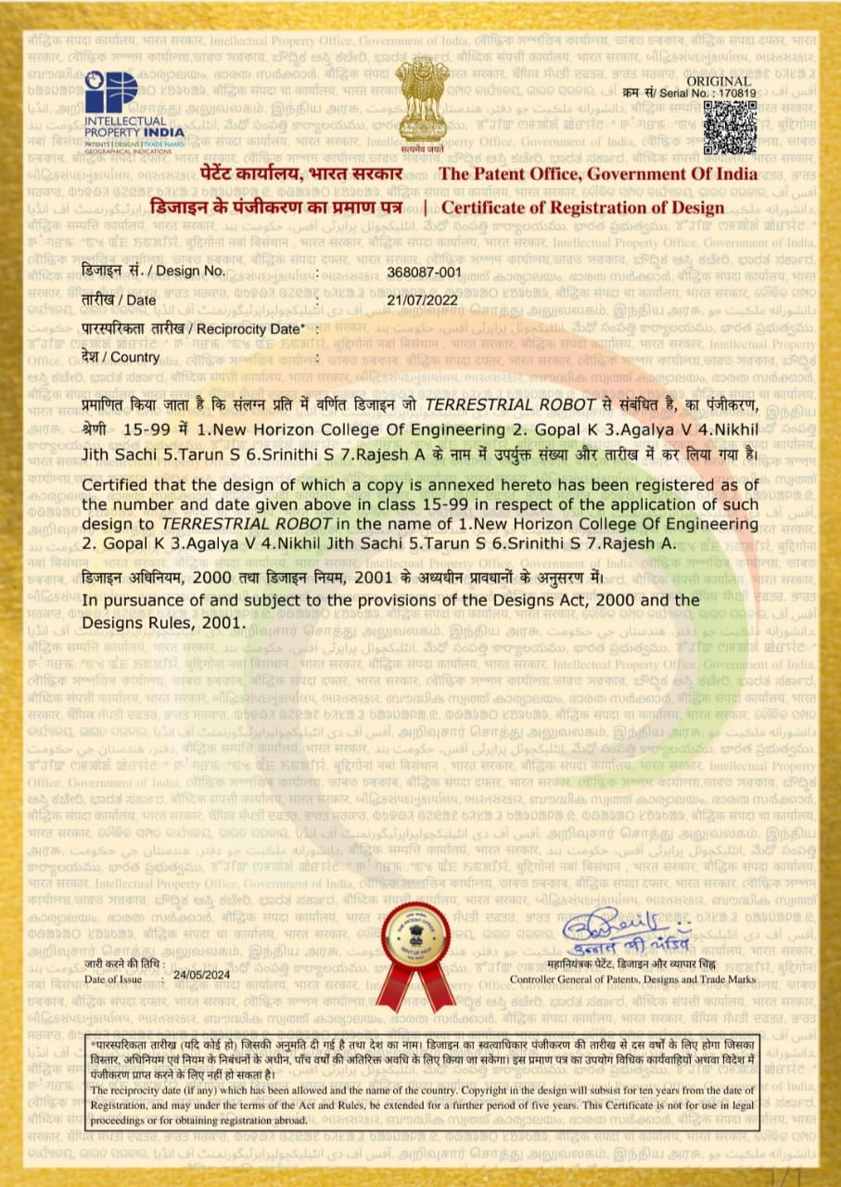
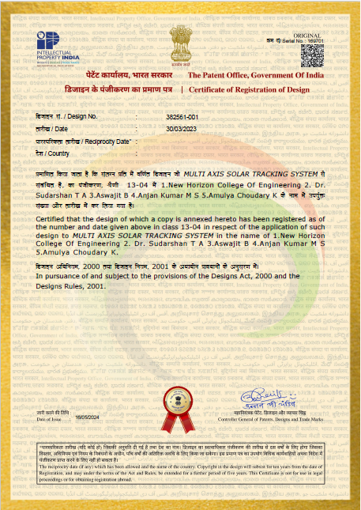


NHCE IPR Cell
NHCE is committed to its vision and mission of developing innovative technologies. The institute encourages the teaching fraternity, students and researchers to utilize intellectual property rights like patents, industrial designs, trademarks, and copyrights to protect their novel ideas. Through awareness programs and workshops, NHCE aims to motivate and initiate novel ideas/technology and gain legal rights over the same. The IPR Cell at NHCE has achieved a significant milestone by publishing over 600 patents and obtaining 45 granted patents and designs.
Activity | Total
Patent Published | 660
Design Grant | 59
Patent Grant | 6

Slide 10

Ph. D/M. Sc. (Engineering) Programs
NHCE has Ten VTU recognised Research Centres which offer Ph. D and M.Sc. (Engineering) by research programs. Eligible candidates from academic institutions, Industry are encouraged to enrol for part time / Full time Ph. D / M.Sc. by research programs. Scholarship scheme is available for Full time scholars as per the Institution policy. Admission to the program is governed by VTU regulations.
VTU recognised research centres @ NHCE
Computer Science and Engineering
Electronics and Communication Engineering
Electrical and Electronics Engineering
Mechanical Engineering
Information Science and Engineering
Management Studies
Computer Applications
Physics
Chemistry
Mathematics
Research Supervisors, area of specialisation is available at https://researchnhce.newhorizoncollegeofengineering.in/research-centers/
VTU Research Supervisors : 91
VTU Research Scholars : 112
VTU Research Scholars Graduated : 30

Slide 11
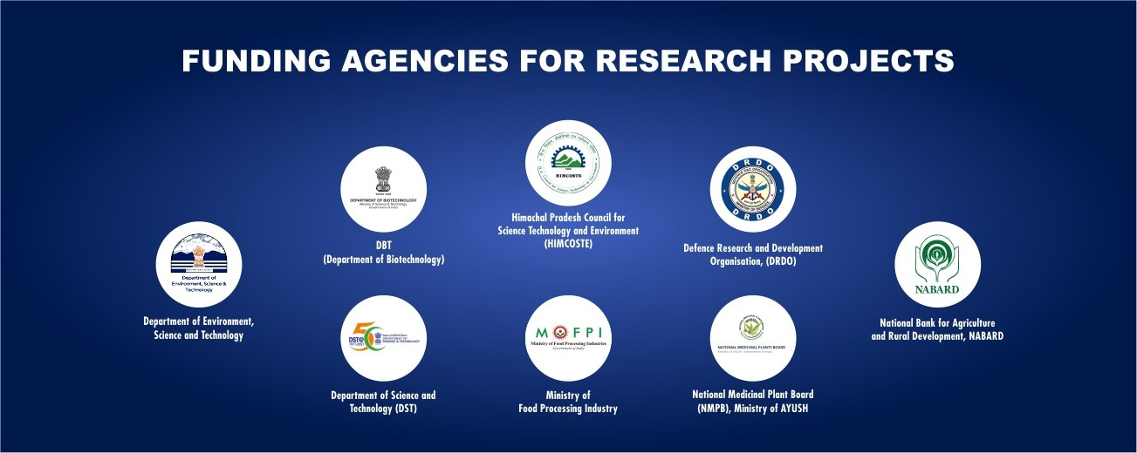

Slide 12

IIC Innovation Ambassador: 52
Journey of IIC
New Horizon College of Engineering (NHCE) established its Institution's Innovation Council (IIC) in December 2018, under the guidance of MHRD's Innovation Cell (MIC). The council, abbreviated as NHCE-IIC, aims to foster an entrepreneurial culture of innovation and intellectual property rights (IPR) among students. It regularly organizes entrepreneurship-related events, as well as idea, POC, and prototype-building competitions to encourage students to create and develop start-ups. The council also trains faculty members as MIC Innovation Ambassadors, who serve as theme mentors for other IICs. It encourages participation of the students in various forums like SIH, KAPILA, NISP, NIPAM and YUKTI.
4-Star Rating from Ministry of Education’s Innovation Cell
Key Achievements:
77 Ideas Submitted – Encouraging creative problem-solving
40 Innovations Developed – Transforming ideas into impactful solutions
20 Startup Ideas Proposed – Fostering entrepreneurial spirit
Impact:
Strengthened innovation & research culture
Encouraged student & faculty participation in innovation challenges
Boosted startup ecosystem through IIC initiatives
Driving Innovation & Entrepreneurship for a Brighter Future

Slide 13
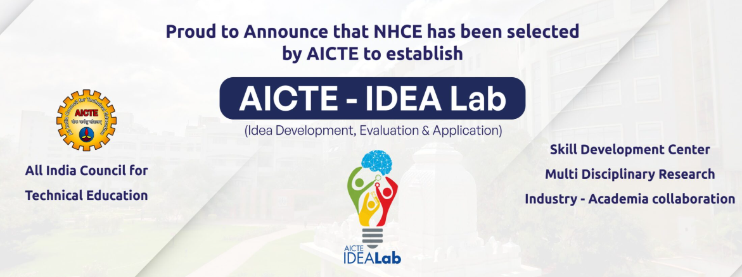
AICTE IDEA Lab – Empowering Innovation & Hands-on Learning
Enhancing experiential learning, innovation, and industry-academia collaboration.
Key Facilities: 3D Printing, CNC Machines, IoT, AI, Robotics, PCB Fabrication, Advanced Software.
Funding: AICTE support with institution & industry collaboration.
Benefits:
Fosters entrepreneurship & startups
Supports patents & prototype development
Bridges academia & industry gap
Encourages hands-on skill development
Impact: Innovation centers, research publications, hackathons, and skill-based learning for future-ready engineers.

Slide 14

New Horizon College of Engineering (STB66131)
Name of the Student Branch Chapter | Establishment Year | SBC Details
IEEE Women in Engineering | 2022 | New Horizon College of Engineering, WIE (SBA66131)
IEEE Power Electronics Society | 2020 | New Horizon College of Engineering, PEL35 (SBC66131)
IEEE Robotics and Automation Society | 2022 | New Horizon College of Engineering, RA24 (SBC66131A)
IEEE Industrial Electronics Society | 2022 | New Horizon College of Engineering, IE13 (SBC66131B)
IEEE Computer Society & IEEE Sensor Council | 2023 | New Horizon College of Engineering, C16, SEN39 (SBC66131C)
IEEE Power and Energy Society | 2023 | New Horizon College of Engineering, PE31(SBC66131D)
IEEE Microwave Theory and Technology Society | 2023 | New Horizon College of Engineering, MTT17 (SBC66131E)
IEEE Dielectrics and Electrical Insulation Society | 2025 | New Horizon College of Engineering, DEI32 (SBC66131F)
IEEE Transportation Electrification Council | 2025 | New Horizon College of Engineering, TEC802 (SBC66131G)
IEEE Council on Superconductivity | 2025 | New Horizon College of Engineering, CSC41 (SBC66131H)
IEEE Biometrics Council | 2025 | New Horizon College of Engineering, BIO46 (SBC66131I)
IEEE Nanotechnology Council | 2025 | New Horizon College of Engineering, NANO42 (SBC66131J)
IEEE Systems, Man and Cybernetics Society | 2025 | New Horizon College of Engineering, SMC28 (SBC66131K)
IEEE Circuits and Systems Society | 2025 | New Horizon College of Engineering, CAS04 (SBC66131L)
IEEE Computational Intelligence Society | 2025 | New Horizon College of Engineering, CAS04 (SBC66131M)

Slide 15


Slide 16
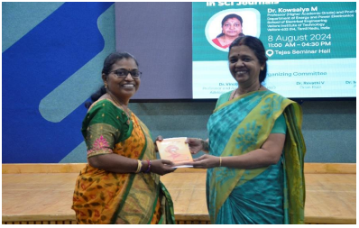
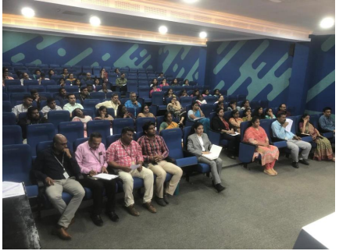
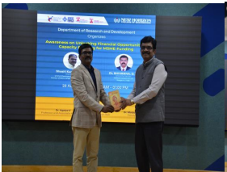
Research Awareness Activities Conducted
TITLE | DATE
Workshop on “Art of Writing a Research Paper in SCI Journals” | 08.08.2024
Workshop on “Research Grant Proposal Writing for DST” | 21.08.2024
Expert Talk on “Awareness on Unlocking Financial Opportunities: Capacity Building for MSME Funding” | 28.08.2024
Webinar on “IEEE Authorship and Open Access Symposium” | 04.09.2024
Expert Talk on “Interdisciplinary Research- An approach to address social challenges” | 11.09.2024
Expert Talk on “Research in IoT and Smart Buildings” | 18.09.2024
Expert Talk on “Research in Industrial Application” | 28.09.2024
Workshop on “Research Output Optimization” | 24.10.2024
Workshop on “Research Output Optimization” | 11.11.2024
Short Term Training Program (STTP) on “Research Challenges in Advanced Power Converters for Industrial Electronics Applications” | 11.11.2024 to 15.11.2024
Expert talk on Innovations in Research Publications | 04.12.2024
Faculty Development Programme on “Research Potential in Advanced Power Electronics & Renewable Energy” | 13.01.2025 to 24.01.2025
Seminar on “Research Schemes in India and Trust area” Funding for all Science and Engineering Departments | 12.02.2025
Faculty Development Program on “MAXIMISING INNOVATION: IPR Strategies for Science Research” | 02.09.2024
Workshop on “IPR in Electrical Engineering” | 06.09.2024
Faculty Development Program on “Integrating IPR into Business Strategy: A Management Approach” | 31.08.2024
Workshop on “Unlock IP Potential in Artificial Intelligence” | 13.09.2024
Workshop on “Unlock Your Innovation Essential Techniques of Patent Drafting” | 13.09.2024
Lecture Series on “Innovative Research Funding Proposal – An Overview” | 05.11.2023
Lecture Series on “project Writing & Funding Opportunities” | 08.11.2023
Lecture Series on “Funding Opportunities – An Over view” | 23.12.2023
Lecture Series on “Open Network for Digital Commerce (ONDC)- An Overview” | 23.12.2024
Lecture Series on “Smart Research Articles” | 05.01.2024
Lecture Series on “Art of Writing Innovative Research Proposal for Funding– An Overview” | 10.02.2024

Slide 17
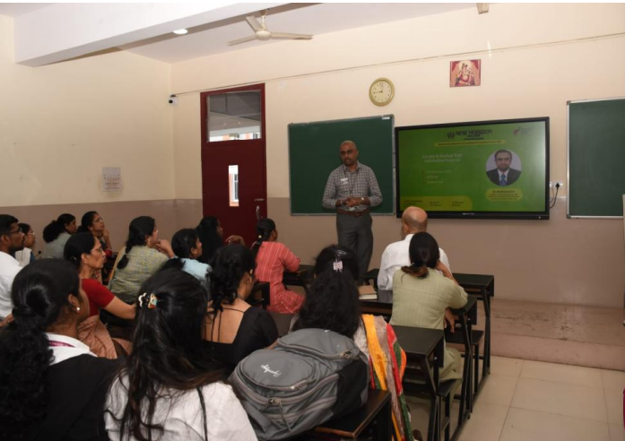
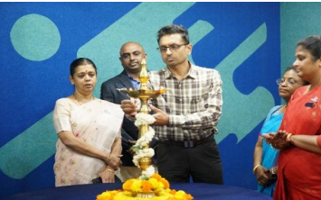
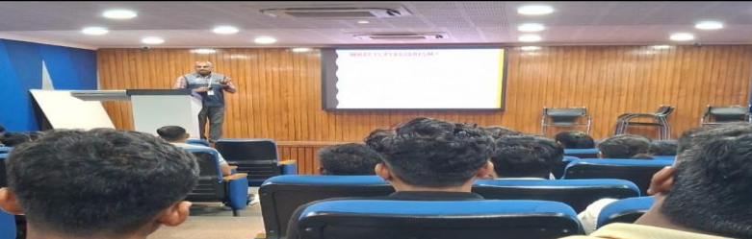
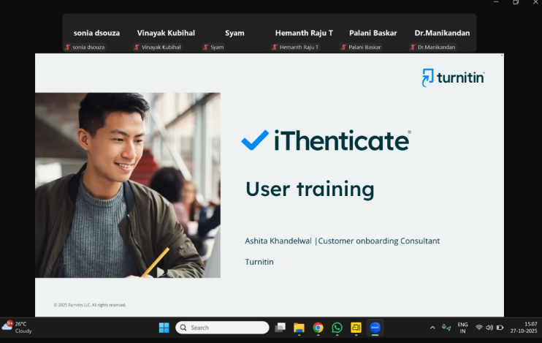
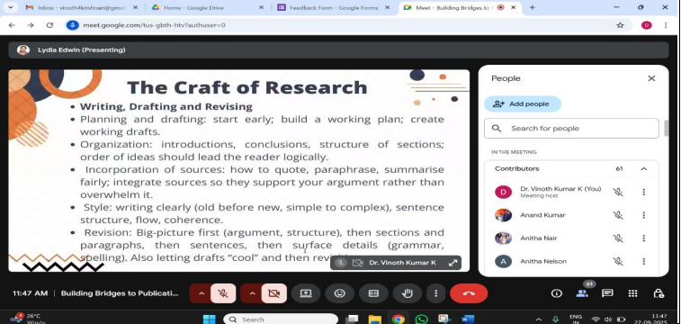
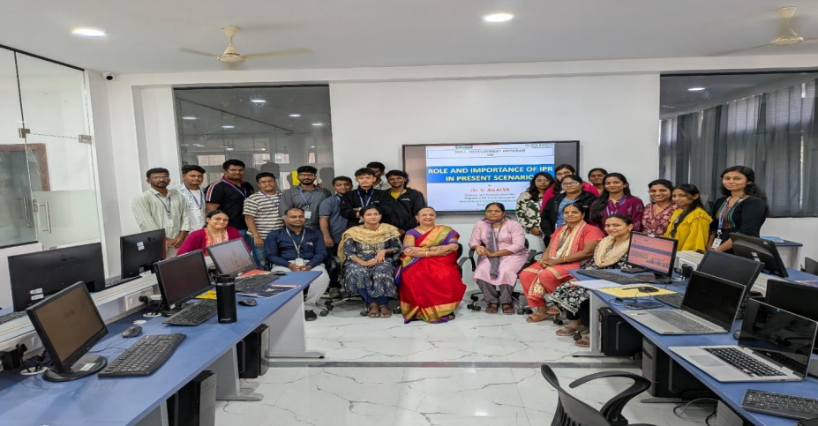
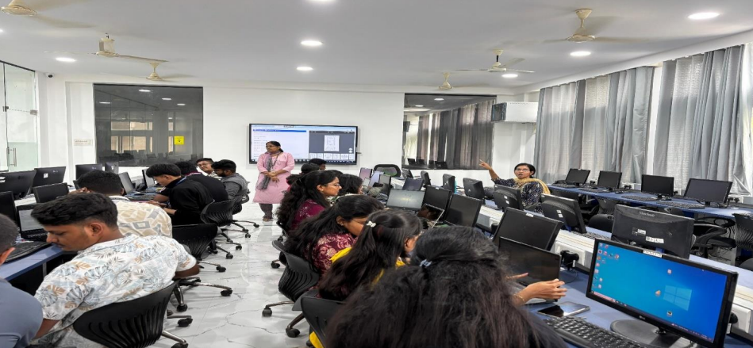
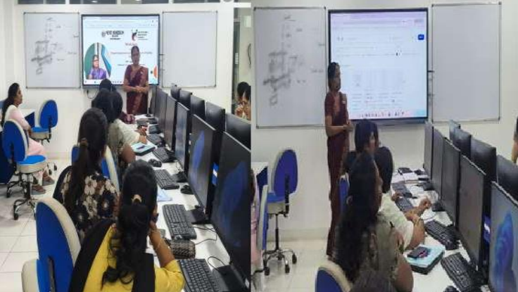
Research Awareness Activities Conducted
TITLE
Seminar on R & D Awareness and Capacity building towards Research Ethics, Funding sources and global best practices – Faculty and Students on 14.11.2025
Short Term Training Program (STTP) on “Research Challenges in Advanced Power Converters for Industrial Electronics Applications” from 12.11.2025 to 13.11.2025
Expert Talk on Innovation in Research Publications on 28.10.2025
Training on Turnitin: How to View and interpret Similarity on 27.10.2025
Building Bridges to Publication: A Workshop on Submitting to Transactions on 27.09.2025
One Day Workshop Role and Importance IPR in the Present scenario on 13.08.2025
Empowering Innovators Through Patent Drafting Skills on 28.08.2025
Expert Talk on “Introduction to IPR & Design Thinking on 28.10.2025
Expert Talk on “Ideas, Innovation and Patents on 31.10.2025
Seminar on Intellectual Property Rights on 6.11.2025
IPR and Significance of Technology Transfer from 26.11.2025 to 27.11.2025

Slide 18

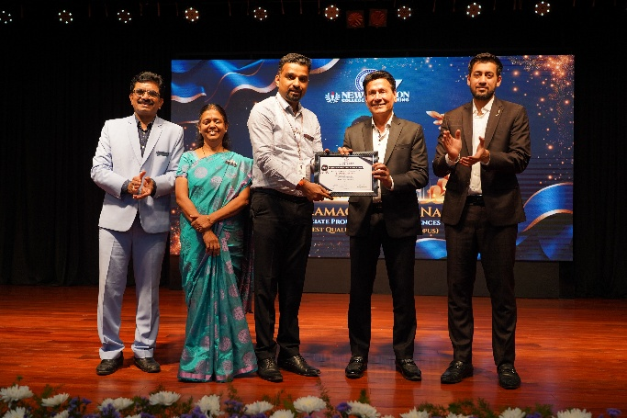
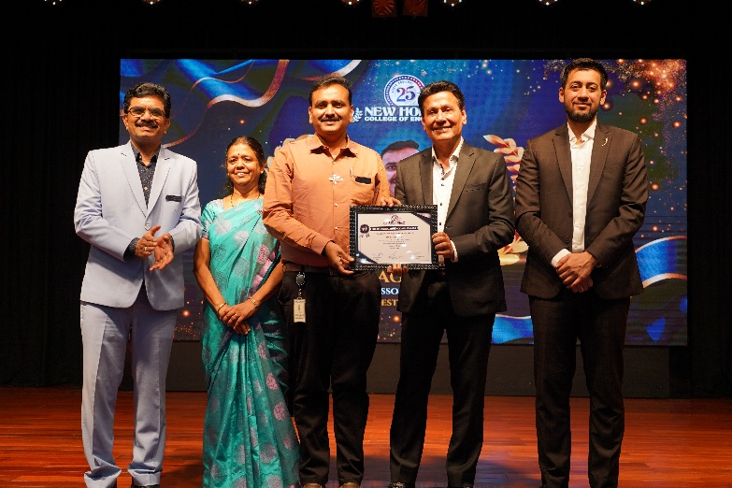
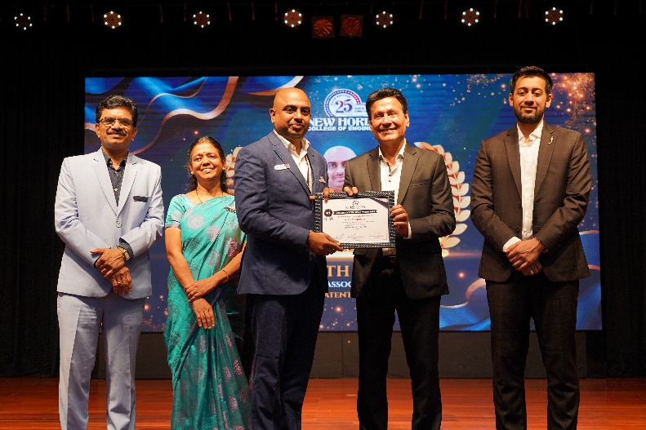
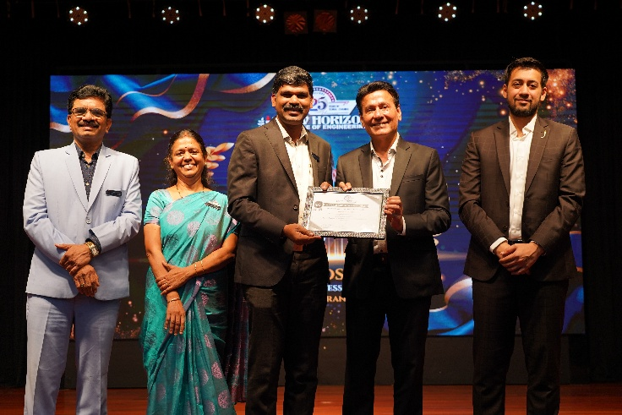
Research Excellence Awards 2024
Highest Quality Publication Award
Highest h-Index Award
Highest Patent Published Award
Highest Research Grants Received Award

